Slide 1
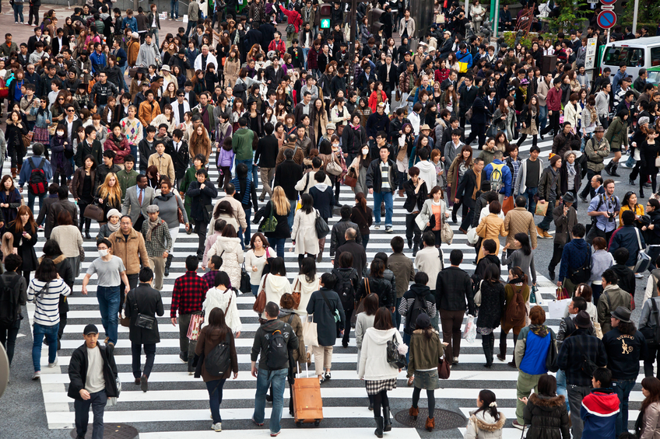

Slide 3
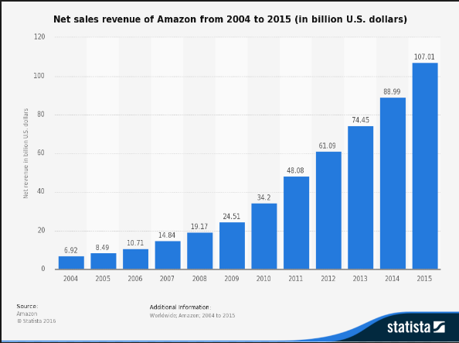
Amazon sales

Slide 4
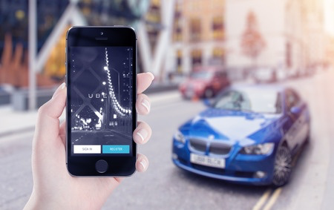
UBER

Slide 5
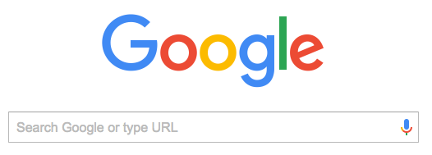

Slide 6
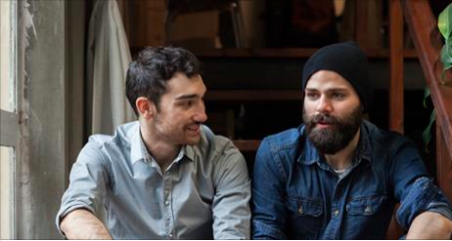

Slide 8
It’s the perfect environment for God to speak to them.

Slide 9
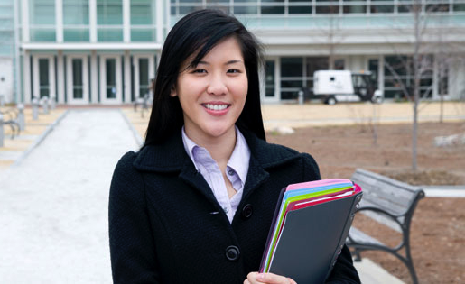
Over 900 people every day, tell us they asked Jesus into their lives, while on the site.

Slide 11
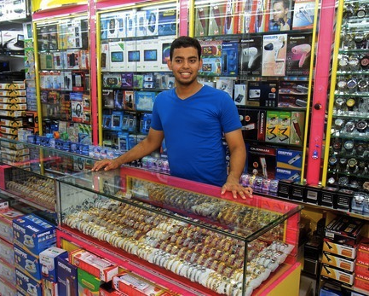
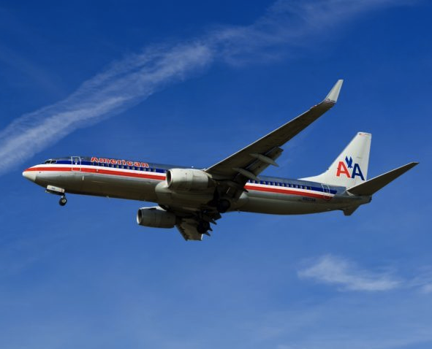

Slide 12
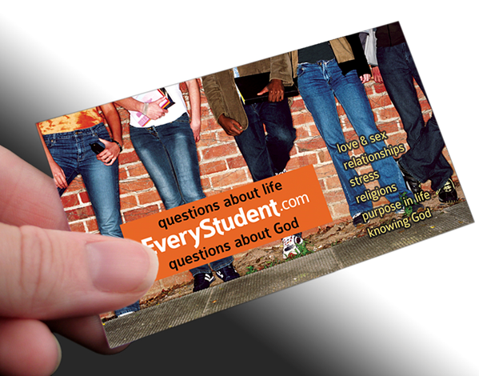

Slide 13
“Perhaps no one has ever shared with you how you could know God like that. May I give you a card to a website where you can explore your questions about God?”

Slide 14
I am so thankful for EveryStudent.com. Right now I’m in a relationship with God. It’s true that we are designed to be in a relationship with him. I feel Complete. I’m inspired to help others know God. ~ Eric

Slide 17
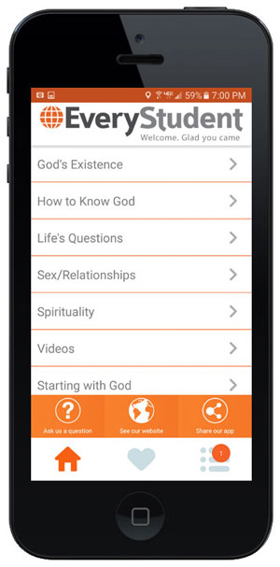

Slide 18
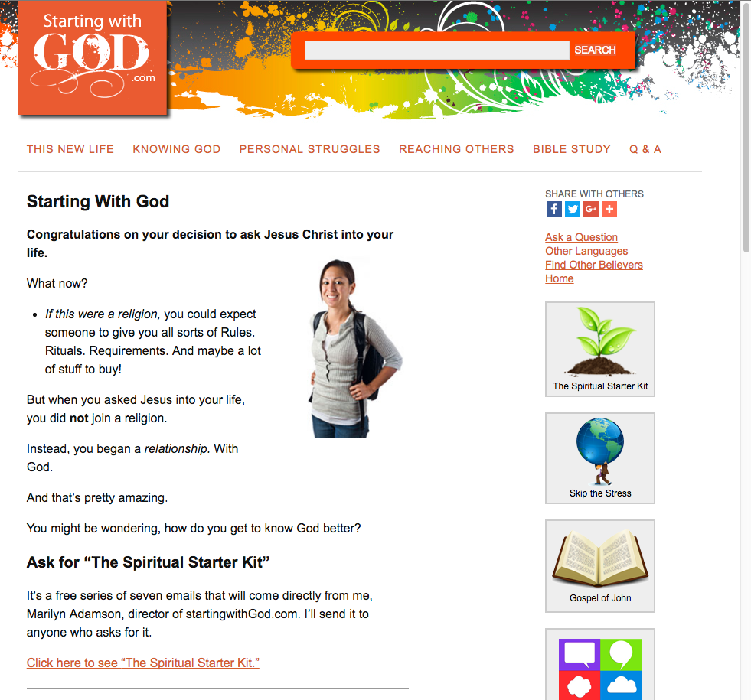

Slide 19
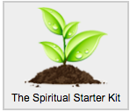
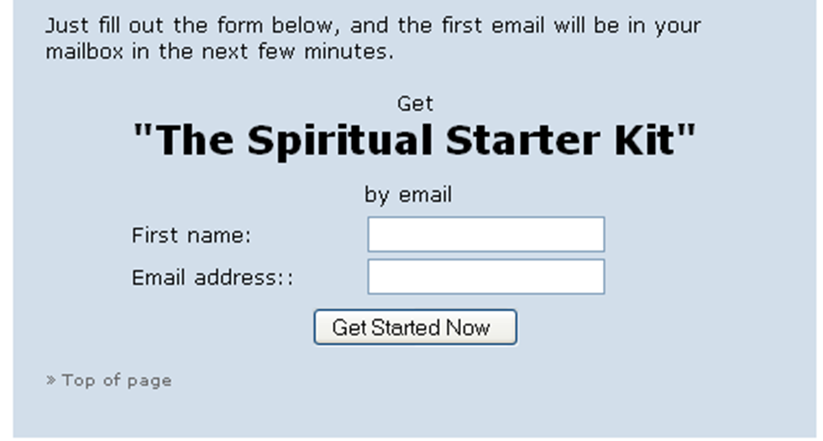

Slide 20
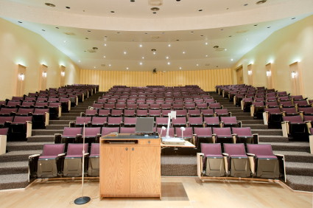

Slide 21
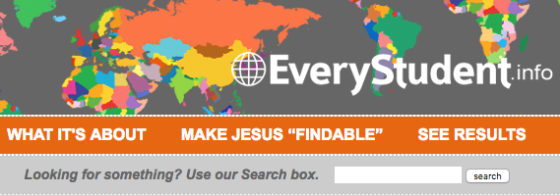
EveryStudent.info

Slide 22
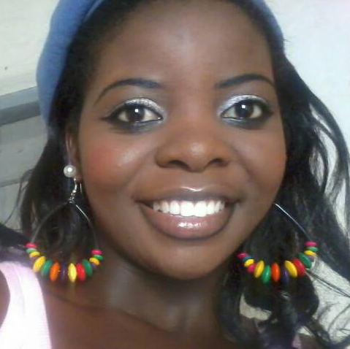
“Thanks. God bless u for changing my life.” ~ Vashti

